Slide 1
Project Participants
1-Rasika Sawale
2-Abhijit Shejal
3-Sunil Bhagwat
4-Tarun Borkar
5-Yogesh Jamdade

Slide 2
Problem Statement
Customer is satisfied from the product or not
Super market customer satisfaction
On the basis of customer review we are predicting customer is satisfied or not.
On the basis of customer review they are satisfied from product or not.
Super market sales prediction on the basis of customer review .

Slide 3
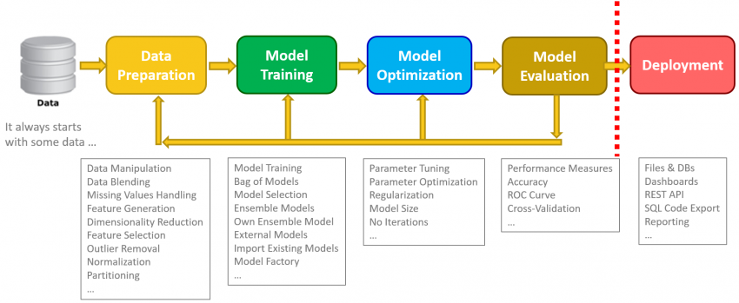
Data SCIENCE PROCESS

Slide 4
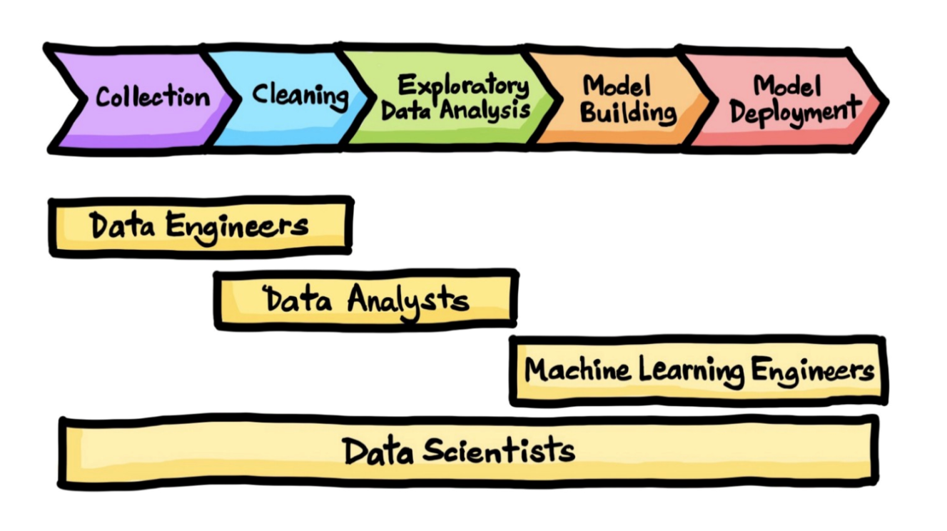
STEPS OF DATA SCIENCE PROJECT
Problem statement
Data Gathering
Exploratory Data Analysis (EDA)
Feature Engineering
Feature Selection
Model Training
Model Evaluation
Web Deployment Framework
Deployment (Deployment on cloud)

Slide 5
1. Problem statement
The purpose of the problem statement is to identify the issue that is a concern and focus it in a way that allows it to be studied in a systematic way.
It defines the problem and proposes a way to research a solution, or demonstrates why further information is needed in order for a solution to become possible.

Slide 6
2. Data gathering
Data gathering is the process of data collection, measuring, and analyzing accurate data from a variety of relevant sources to find answers to research problems, answer questions, evaluate outcomes, and forecast trends and probabilities.
We Gathering Data by using Databases
My Sql
Mongo DB
Client database (Mongo, SQL, Oracle, S3, SFTP, Hive)
CSV from client 3. Market Research team will provide the same
Row ---> 9 lakh - 1 / 1.5 millions
Column ---> 50-70 total column ~ After feature selection we are having 25 column

Slide 7
3. Exploratory Data Analysis (EDA)
Missing Values
Duplicate value
Outlier Detection

Slide 8
4. Feature engineering
Feature Engineering is one of the most crucial tasks and plays a major role in determining the outcome of a model.
Feature Engineering encapsulates various data engineering techniques such as following:-
Scaling :-
Type of scaling:-
Standardization / Normalization : ( Unit Price , Quantity , Tax , Total Price , Cost of good sold , Gross Income )
2. Encoding
One Hot Encoding ( Branch , City , Product line , Payment )
Label Encoding : (Gender , Customer Type )
3.Binning : ( Rating )

Slide 9
5. Feature selection
Methods of Feature Selection
Filter Method : ( Chi-Square test , ANNOVA test )
Wrapper Method : ( Exhaustive , Bi-directional ,Recursive)
Embedded Method : ( Random Forest / Decision Tree Feature Importance )

Slide 10
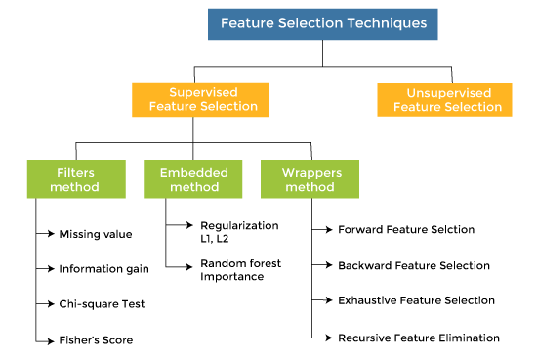

Slide 11
6. Model training

Slide 12
Some of the most often used categorization ml algorithms are listed below.
K-Nearest Neighbor
Naive Bayes
Decision Trees
Random Forest -( 87 % )
Support Vector Machine
Logistic Regression

Slide 13
For Clasification :-
Confusion Metrics
Classification report ( Accuracy, Precision, Recall , F-beta-score)
AUC (Area under curve) and ROC (receiver operating characteristic curve)
Accuracy
Precision
Recall
F-beta-score

Slide 14
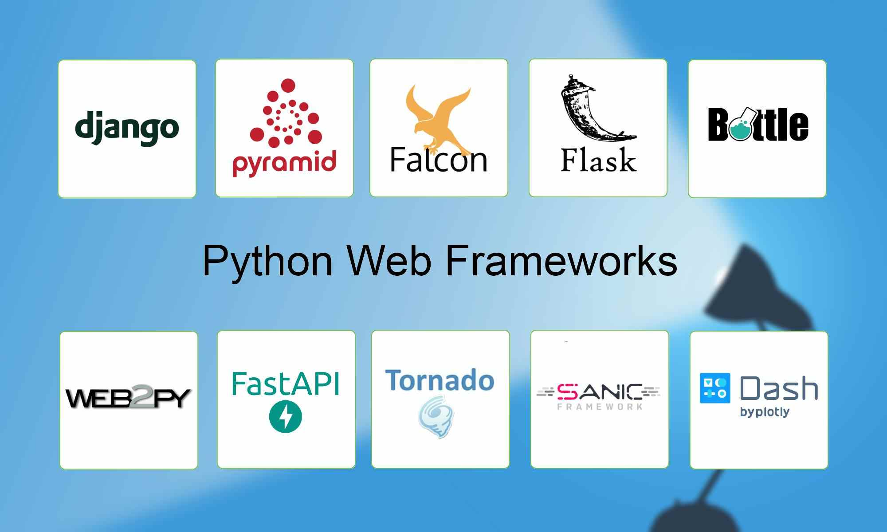
7. Web Deployment Framework

Slide 15
Web Deployment Framework
A web development framework is a set of resources and tools for software developers to build and manage web applications, web services and websites.
Such a framework includes templating capabilities for presenting information within a browser, the programming environment for scripting the flow of information and the application programming interfaces (APIs) for accessing underlying data resources.
Fask API (Application Programming Interface)

Slide 16
The End

